Slide 1
Computer Algorithms
Dr. Ashish Seth

Slide 2
What is a Computer Algorithm?
A computer algorithm is
  a detailed step-by-step method for
  solving a problem
  by using a computer.
  Properties
  Finiteness
  Unambiguous
  Definiteness of sequence
  Input /Output defined
  Feasibility

Slide 3
Design Techniques -Problem Solving Strategies
Divide & Conquer
Greedy Method
Branch & Bound
Backtracking
Dynamic Programming
Brute Force
Randomized

Slide 4
Problem Solving Using Computers
Problem:
Strategy:
Algorithm:
  Input:
  Output:
  Step:
Analysis:
  Time & Space:
  Optimality:
  Correctness:
Implementation:
Verification:

Slide 5
Example: Search in an unordered array
Problem:
  Let E be an array containing n entries, E[0], …, E[n-1], in no particular order.
  Find an index of a specified key K, if K is in the array;
  return –1 as the answer if K is not in the array.
Strategy:
  Compare K to each entry in turn until a match is found or the array is exhausted.
  If K is not in the array, the algorithm returns –1 as its answer.

Slide 6
Example: Sequential Search, Unordered
Algorithm (and data structure)
  Input:
  E, n, K, where E is an array with n entries (indexed 0, …, n- 1), and K is the item sought.
  Output:
  Returns ans, the location of K in E (-1 if K is not found)

Slide 7
Algorithm: Step (Specification)
int seqSearch(int[] E, int n, int K)
int ans, index;
ans = -1; // Assume failure.
for (index = 0; index < n; index++)
if (K == E[index])
ans = index; // Success!
break; // Done!
return ans;

Slide 8
Analysis of the Algorithm
we measure the amount of work done by an algorithm.
Basic Operation:
  Comparison of x with an array entry
Worst-Case Analysis:
  Let W(n) be a function.
  W(n) is the maximum number of basic operations performed by the algorithm on any input size n.
  For our example, clearly W(n) = n.
  The worst cases occur when K appears only in the last position in the array OR when K is not in the array at all.

Slide 9
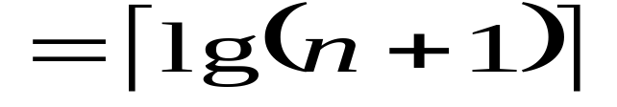
More Analysis of the Algorithm
Optimality:
  The Best possible solution?
  Searching an Ordered Array
  Using Binary Search
  W(n) = Ceiling[lg(n+1)]
  The Binary Search algorithm is optimal.

Slide 10
Correctness can be proved!
Correctness: (proving correctness of procedures)
An algorithm consists of sequences of steps
(operations, instructions, statements) for transforming
inputs (preconditions) to outputs (postconditions)
Proving
  if the preconditions are satisfied,
  then the postconditions will be true,
  when the algorithm terminates.

Slide 11
Algorithm Language (Specifying the Steps)
Java/C++ as an algorithm language can be used
steps within an algorithm may be specified in pseduocode (English phrases)
Focus on the strategy and techniques of an algorithm, not on detail implementation

Slide 12
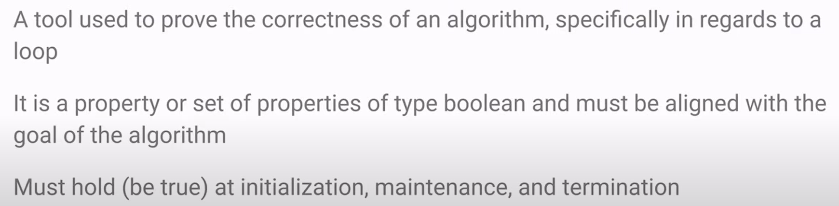
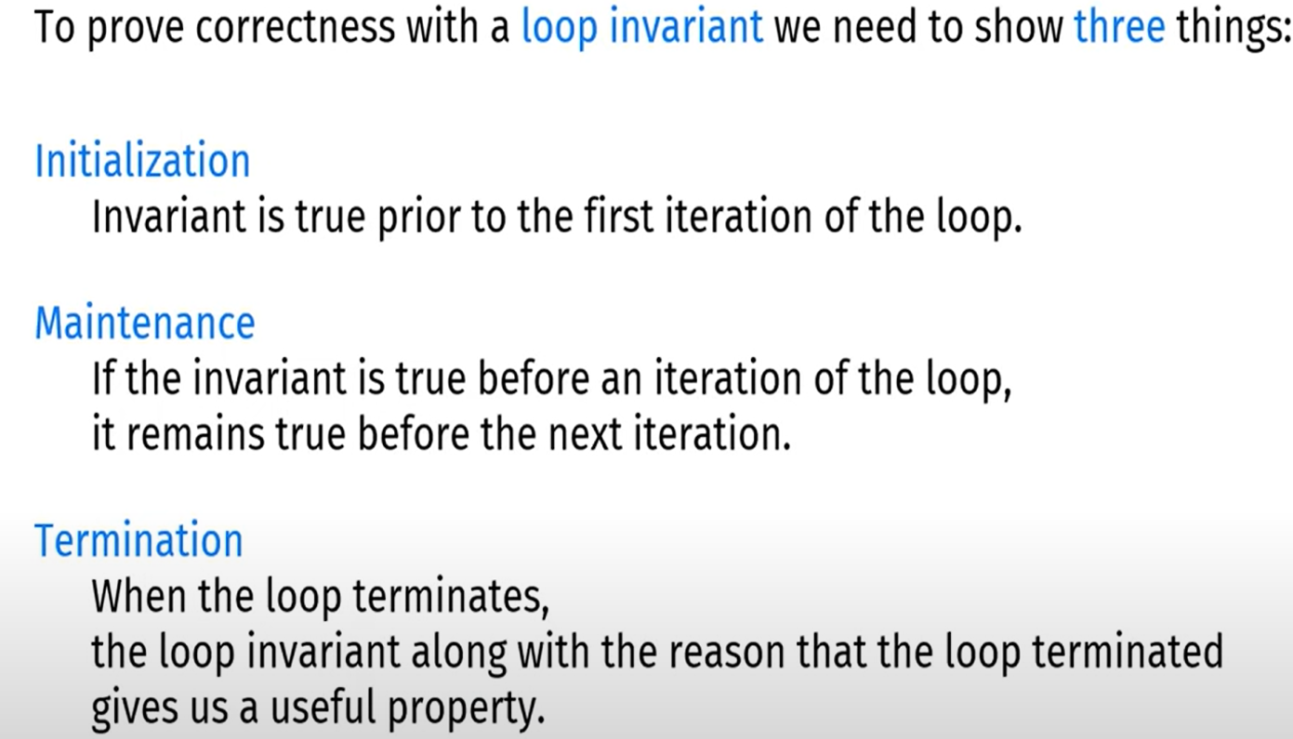
Loop Invariant – Analysing Correctness of Algorithm
Notes:
A loop invariant is a condition or property that remains true at specific points during the execution of a loop. Specifically, it is true: Before the first iteration of the loop begins, At the beginning of each subsequent iteration, After each iteration completes, and When the loop finally terminates.
This "invariant" property means that even though the variables and state within the loop might change with each iteration, this particular condition always holds true at these key points.
Think of it like this: Imagine a magic trick where a ball is hidden under one of three cups. The magician moves the cups around, but the rule is that the ball always stays under one of the cups. That rule ("the ball is under one of the cups") is the invariant. It's true before the trick starts, after each move, and when the trick ends.
In programming, loop invariants are crucial for proving the correctness of algorithms. If you can define a loop invariant and prove it holds true throughout the loop's execution, then you can be confident that the loop achieves its intended purpose when it finishes.

Slide 13
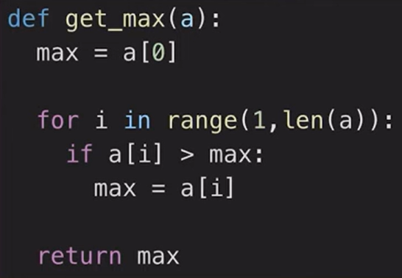
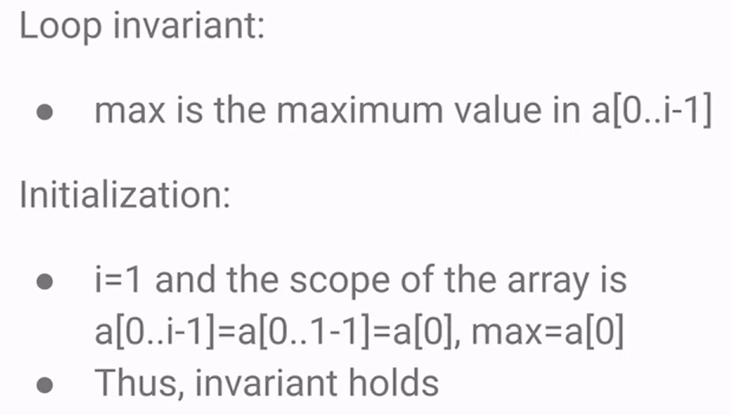
Finding Max value in an array

Slide 14
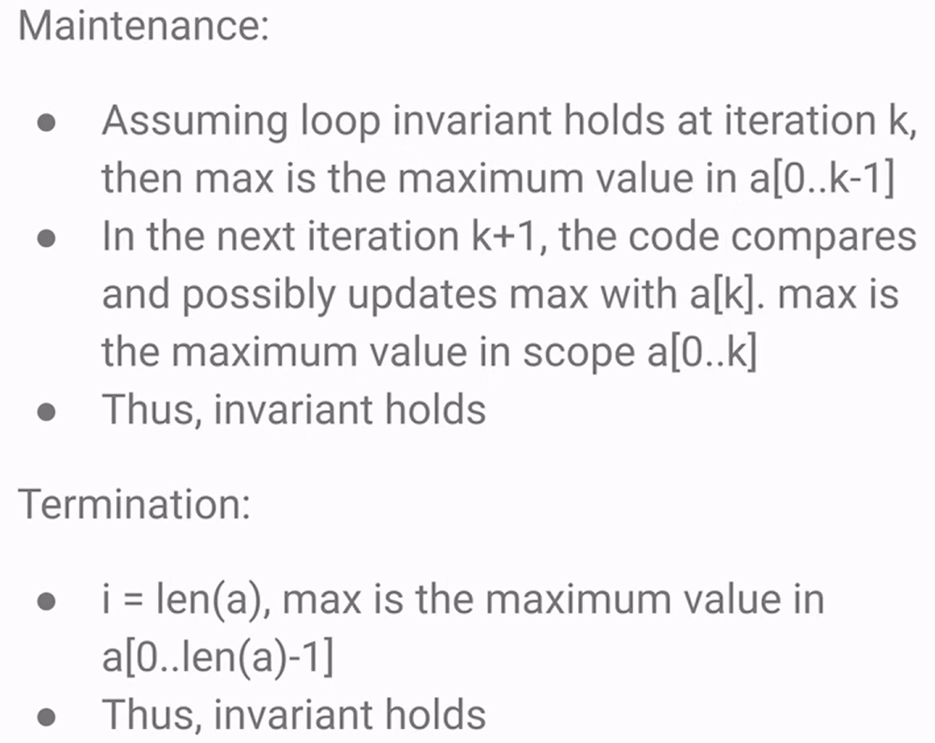
… finding max value in an array

Slide 15
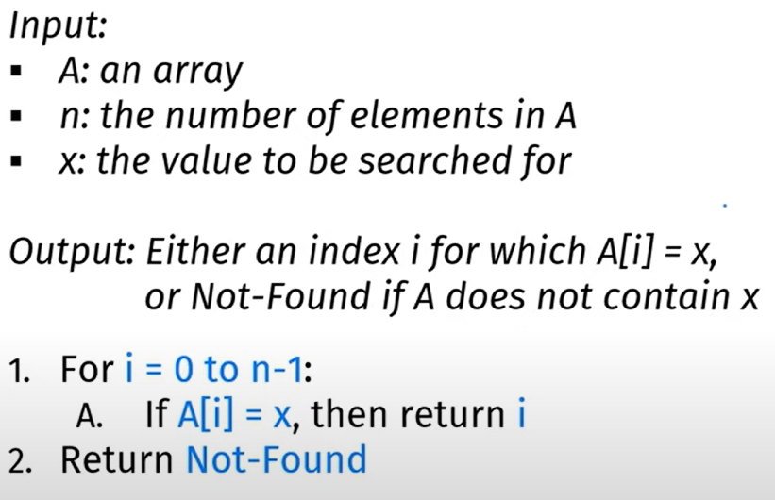

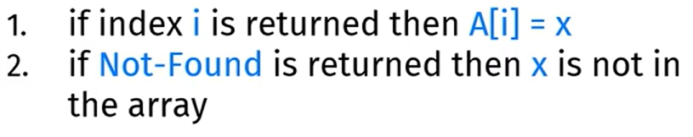
Linear Search

Slide 16
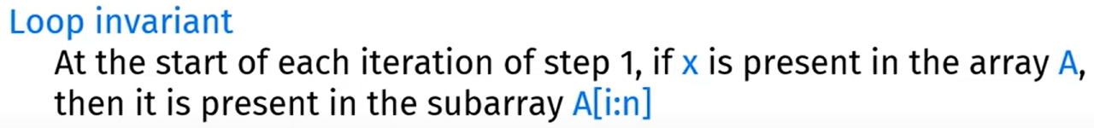
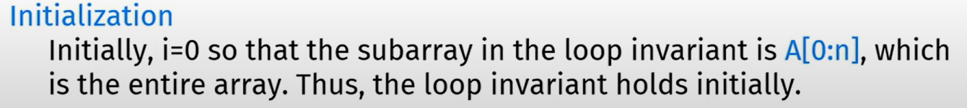
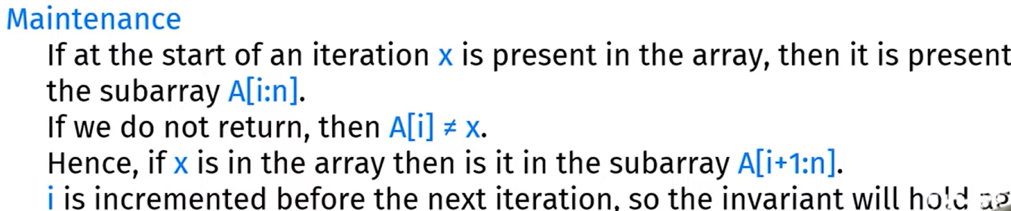

(means now you are at ith index and at this index you have find x)

Slide 17
Amount of work done
  We want a measure of work that tells us something about the efficiency of the method used by the algorithm
  independent of computer, programming language, programmer, and other implementation details.
  Usually depending on the size of the input
Counting passes through loops
Basic Operation
  Identify a particular operation fundamental to the problem
  the total number of operations performed is roughly proportional to the number of basic operations
Identifying the properties of the inputs that affect the behavior of the algorithm

Slide 18
Worst-case complexity
  Let D_{n} be the set of inputs of size n for the problem under consideration, and let I be an element of D_{n}.
  Let t(I) be the number of basic operations performed by the algorithm on input I.
  We define the function W by
W(n) = max{t(I) | I ∈ D_{n}}
  called the worst-case complexity of the algorithm.
  W(n) is the maximum number of basic operations performed by the algorithm on any input of size n.
The input, I, for which an algorithm behaves worst
depends on the particular algorithm.

Slide 19
Space Usage
worst-case analysis can be done.
==> If memory cells used by the algorithms depends on the particular input
Normally a program require space for instructions, constants, variables used by program and input data,
It may also use space for manipulating data and storing information to carry out computations
Fixed part: The size required to store certain data/variables, that is independent of the size of the problem:
  - e.g. name of the data collection
  - same size for classifying 2GB or 1MB of texts
Variable part: Space needed by variables, whose size is dependent on the size of the problem:
  - e.g. actual text
  - load 2GB of text VS. load 1MB of text
Generally we do
Time and Space Tradeoff.

Slide 20
Analysis Tool: Mathematics: Set
A set is a collection of distinct elements.The elements are of the same “type”,
“element e is a member of set S” is denoted as e ∈ S
A particular set is defined by listing or describing its elements between a pair of curly braces:
S₁ = {a, b, c}, S₂ = {x | x is an integer power of 2}
read “the set of all elements x such that x is …”
S₃ = {} = ∅, has not elements, called empty set
A set has no inherent order.

Slide 21
Subset, Superset; Intersection, Union
If all elements of one set, S₁
  are also in another set, S₂,
Then S₁ is said to be a subset of S₂, S₁ ⊆ S₂
  and S₂ is said to be a superset of S₁, S₂ ⊇ S₁.
Empty set is a subset of every set, ∅ ⊆ S
Intersection
S ∩ T = {x | x ∈ S and x ∈ T}
Union
S ∪ T = {x | x ∈ S or x ∈ T}

Slide 22
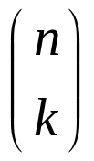
Cardinality
Cardinality
  A set, S, is finite if there is an integer n such that the elements of S can be placed in a one-to-one correspondence with {1, 2, 3, …, n}
  in this case we write |S| = n
How many distinct subsets does a finite set on n elements have? There are 2^{n} subsets.
How many distinct subsets of cardinality k does a finite set of n elements have?
There are C(n, k) = n!/((n-k)!k!), “n choose k”

Slide 23
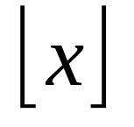
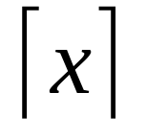
Analysis Tool: Algebra
Manipulating Inequalities
Transitivity: If ((A ≤ B) and (B ≤ C) Then (A ≤ C)
Addition: If ((A ≤ B) and (C ≤ D) Then (A+C ≤ B+D)
Positive Scaling:
If ((A ≤ B) and (α > 0) Then (α A ≤ α B)
Floor and Ceiling Functions
Floor[x] is the largest integer less than or equal to x.
Ceiling[x] is the smallest integer greater than or equal to x.

Slide 24
Logarithms
  For b>1 and x>0, log_{b}x = L such that b^{L} = x
  log_{b} is a strictly increasing function,
  if x > y then log_{b} x > log_{b} y
  log_{b} is a one-to-one function,
  if log_{b} x = log_{b} y then x = y
  log_{b} 1 = 0; log_{b} b = 1; log_{b} xª = a log_{b} x
  log_{b}(xy) = log_{b} x + log_{b} y
  x^{log y} = y^{log x}
  ^{change base:} log_{c}x = (log_{b} x)/(log_{b} c)

Slide 25
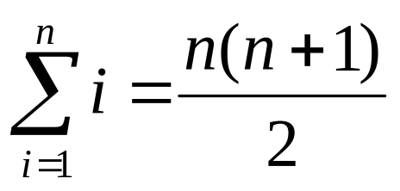
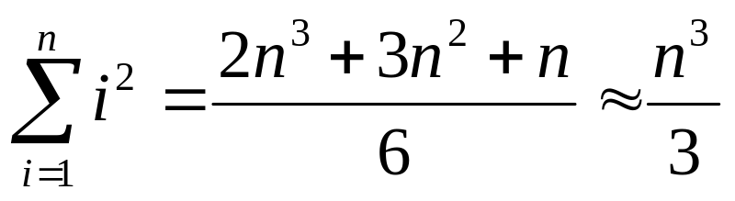
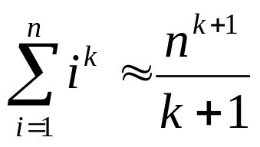
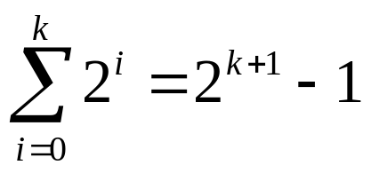
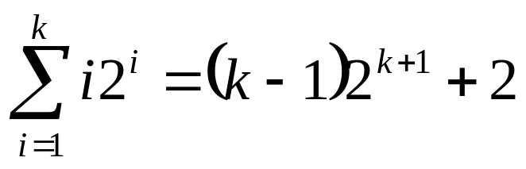
Series
A series is the sum of a sequence.
Arithmetic series
  The sum of consecutive integers
Polynomial Series
  The sum of squares
  The general case is
Power of 2
Arithmetic- Geometric Series

Slide 26
Optimality “the best possible”
Each problem has inherent complexity
  There is some minimum amount of work required to solve it.
To analyze the complexity of a problem,
  we choose a class of algorithms (by specifying the types of operations the algorithm is permitted to perform), and
  Measure of complexity (ex, the basic operations to be counted)
  An algorithm is optimal if there is no algorithm in the class under study that performs fewer operations (in worst case)
  Optimal doesn't mean “best known ” but it means “best possible”

Slide 27
Show whether an algorithm is optimal?
Analyze the algorithm, call it A, and found the Worst-case complexity W_{A}(n), for input of size n.
Prove a theorem starting that,
  for any algorithm in the same class of A
  for any input of size n, there is some input for which the algorithm must perform at least W_{[A]}(n)
  (lower bound in the worst-case)
If W_{A}(n) == W_{[A]}(n)
  then the algorithm A is optimal
  else there may be a better algorithm
  OR there may be a better lower bound.

Slide 28
Optimality e.g.
Problem
  Fining the largest entry in an (unsorted) array of
  n numbers
Algorithm A
  int findMax(int[] E, int n)
  1. int max;
  2. max = E[0]; // Assume the first is max.
  3. for (index = 1; index < n; index++)
  4. if (max < E[index])
  5. max = E[index];
  6. return max;

Slide 29
Analyze the algorithm, find W_{A}(n)
Basic Operation
  Comparison of an array entry with another array entry or a stored variable.
Worst-Case Analysis
  For any input of size n, there are exactly n-1 basic operations
  W_{A}(n) = n-1

Slide 30
Video Lecture of the topic can be found at
Introduction to Computer Algorithms
https://youtu.be/GI1NwGPGxNo
Computer Algorithms - Abstract Data Types (ADT)
https://youtu.be/aHWNxF0c08U
Basics for Analysing Computer Algorithms
https://youtu.be/n1ArVTvMJtE

